Slide 1
services , applets and Project Block Diagram
Prepared By
Md Hasemi Rafsan Jani Shohan
191-33-849(PC B)
L4T3

Slide 2
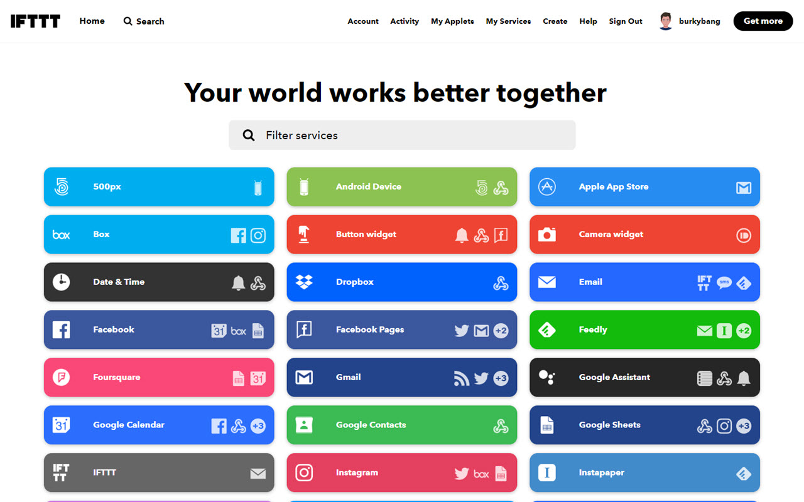
services and applets List

Slide 3
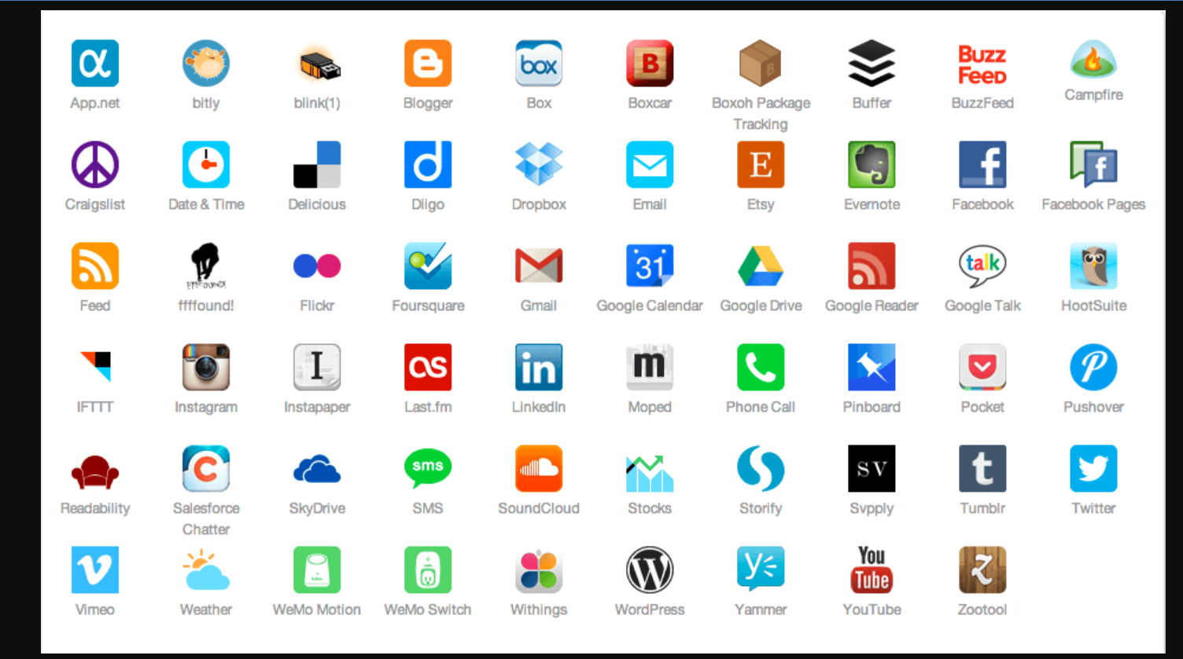
services and applets List

Slide 4
Block Diagram of This Project
Output
Logic Control
Remote Control
IOT Control

Slide 5
Home Automation.
Industrial Machine Controlling.
Weather Monitoring.
Robot’s Arm and Robot Control Car Controlling.
Fire Safety.
Smart Irrigation System Control.
Using Lab use for IOT Smart Trainee Module Board.
Power System And Grid Network Controlling .
Security System Controlling.
Smart Traffic Controlling System.
Smart Electrical Appliance.
Control System.
Medical and ICU Instruments Controlling .

